Slide 1

Global News
Yuqing Yang - Team Leader
Silin Chen,
Jiayu Ding,
Hongsen Wang,
Wenxi Jia,
Shuangding Zhu

Slide 2
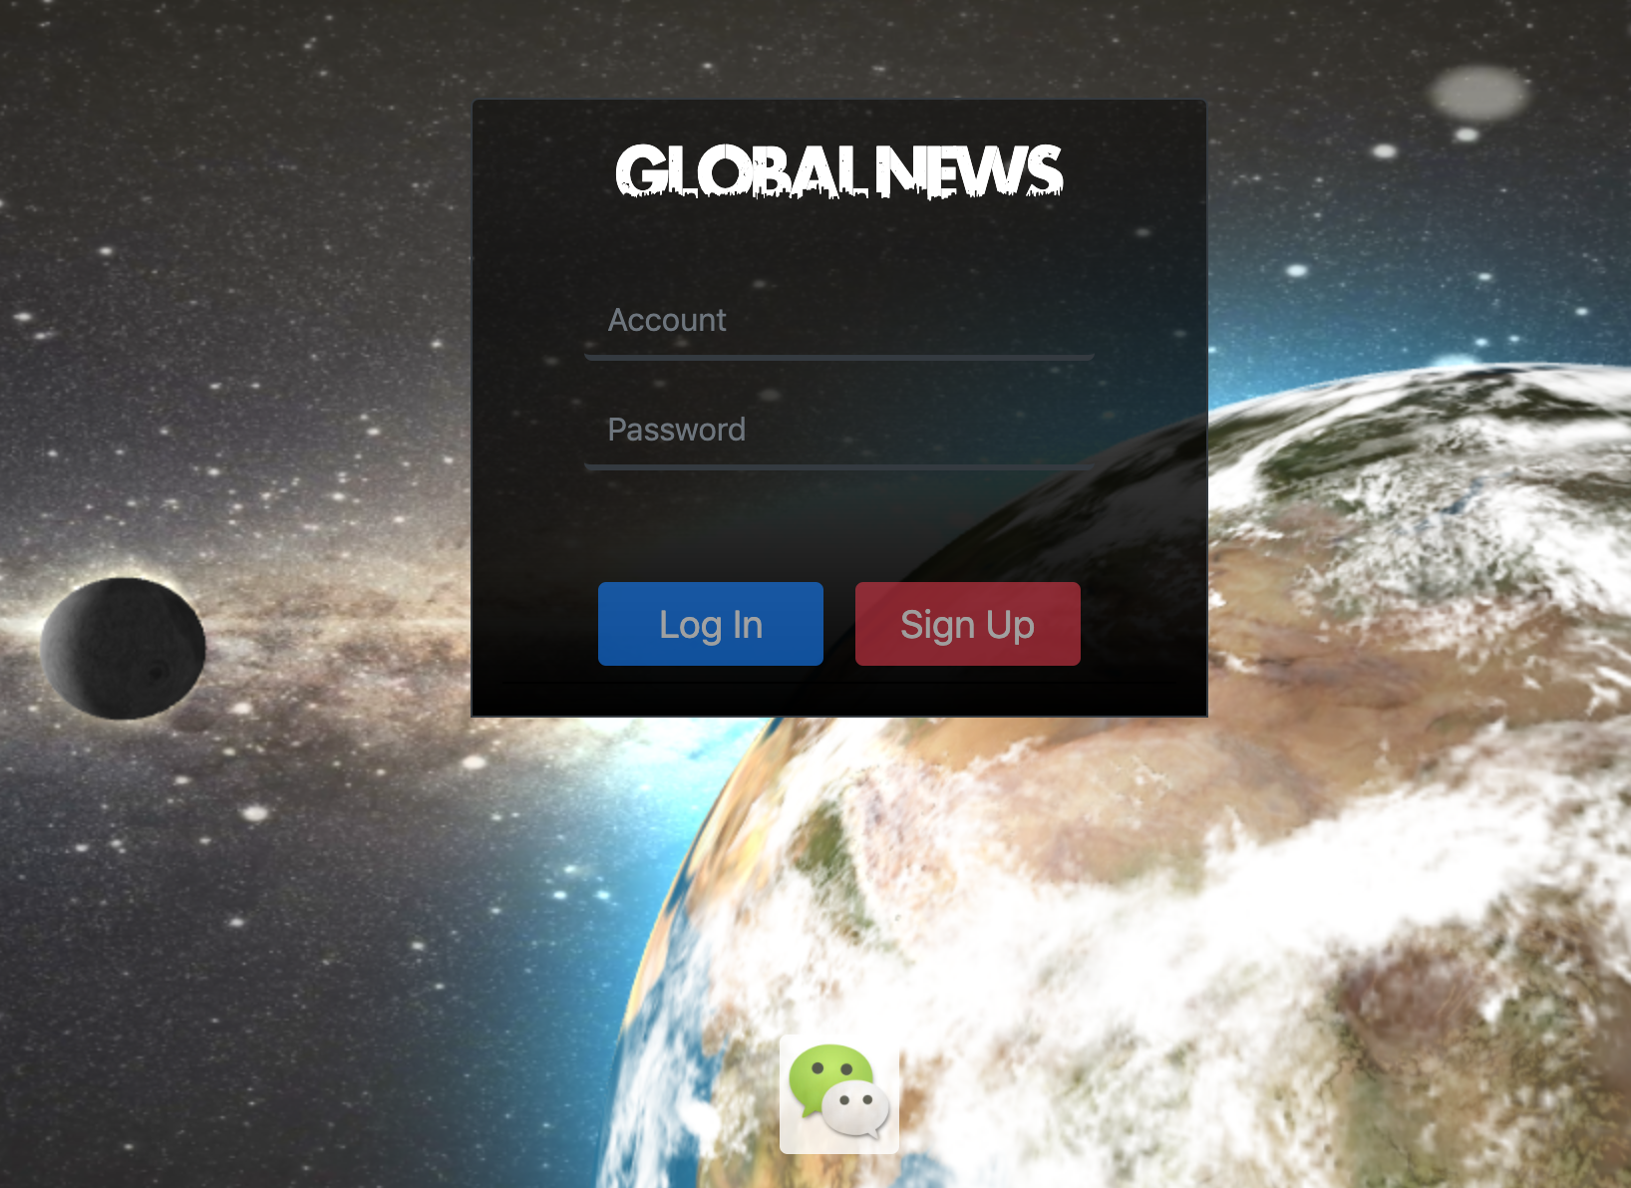
1. Log In / Sign up Page
Log in by user account / Redirect to sign up page

Slide 3
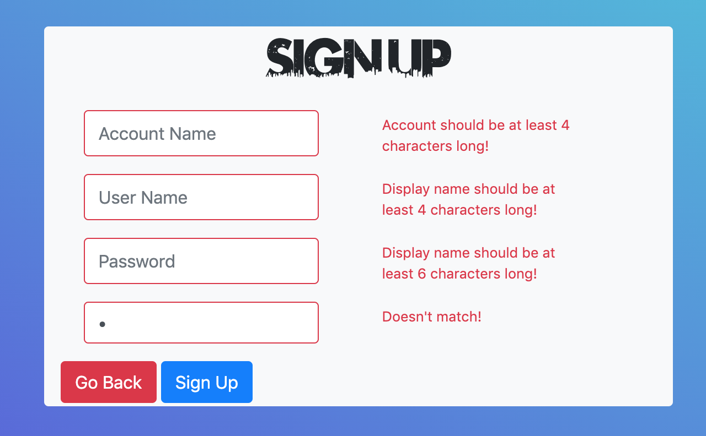
1.1 Sign up
Create a new account by filling out the form

Slide 4
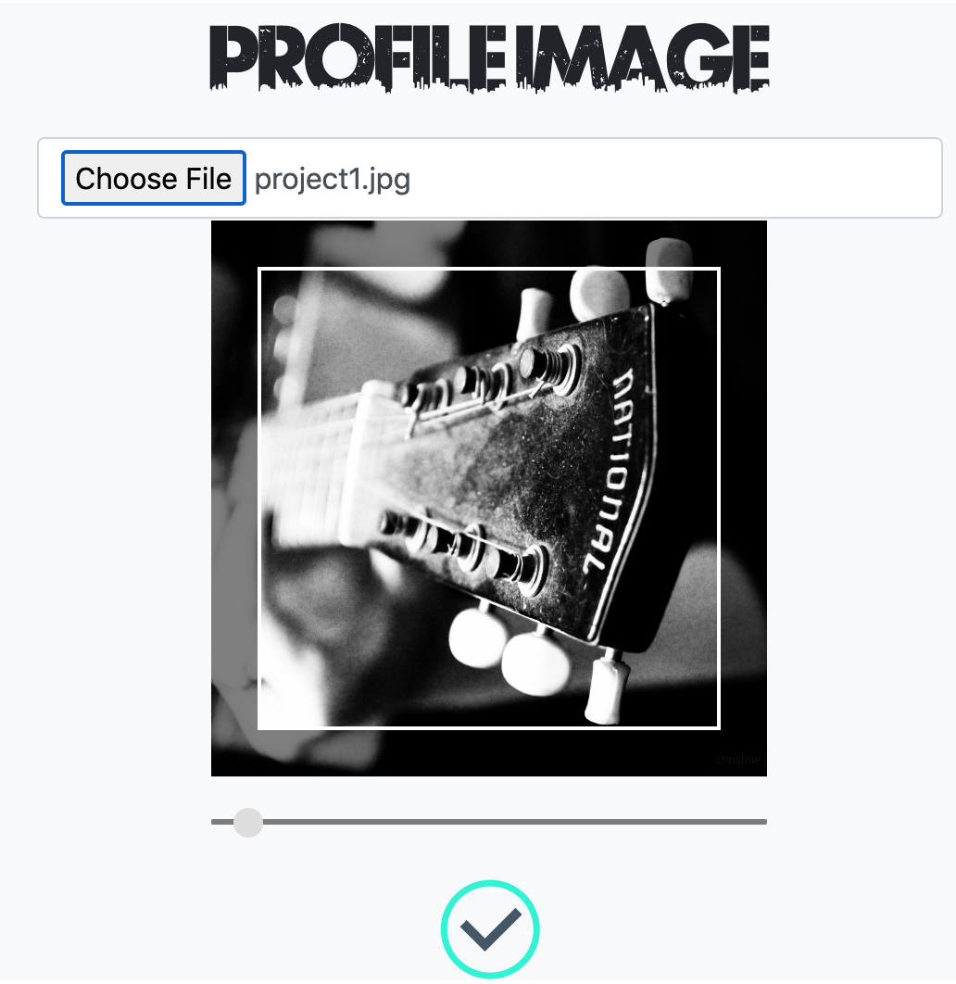
1.2 Choose Profile Image
Select a profile image for the account

Slide 5
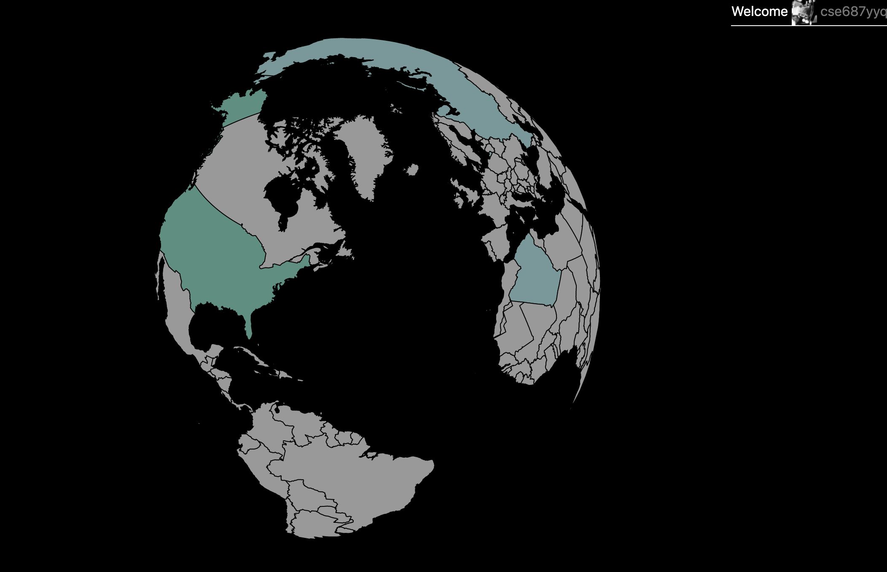
2. Home page
Select a country and to view the news about it

Slide 6
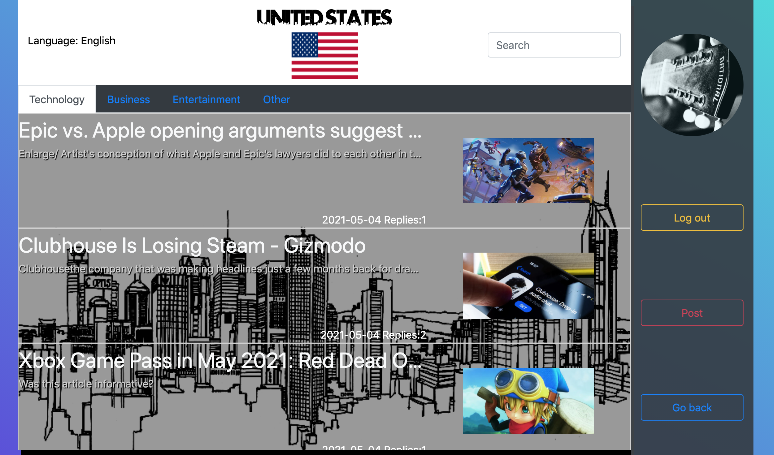
3. News List Page
View the news and search the news / Post a thread

Slide 7
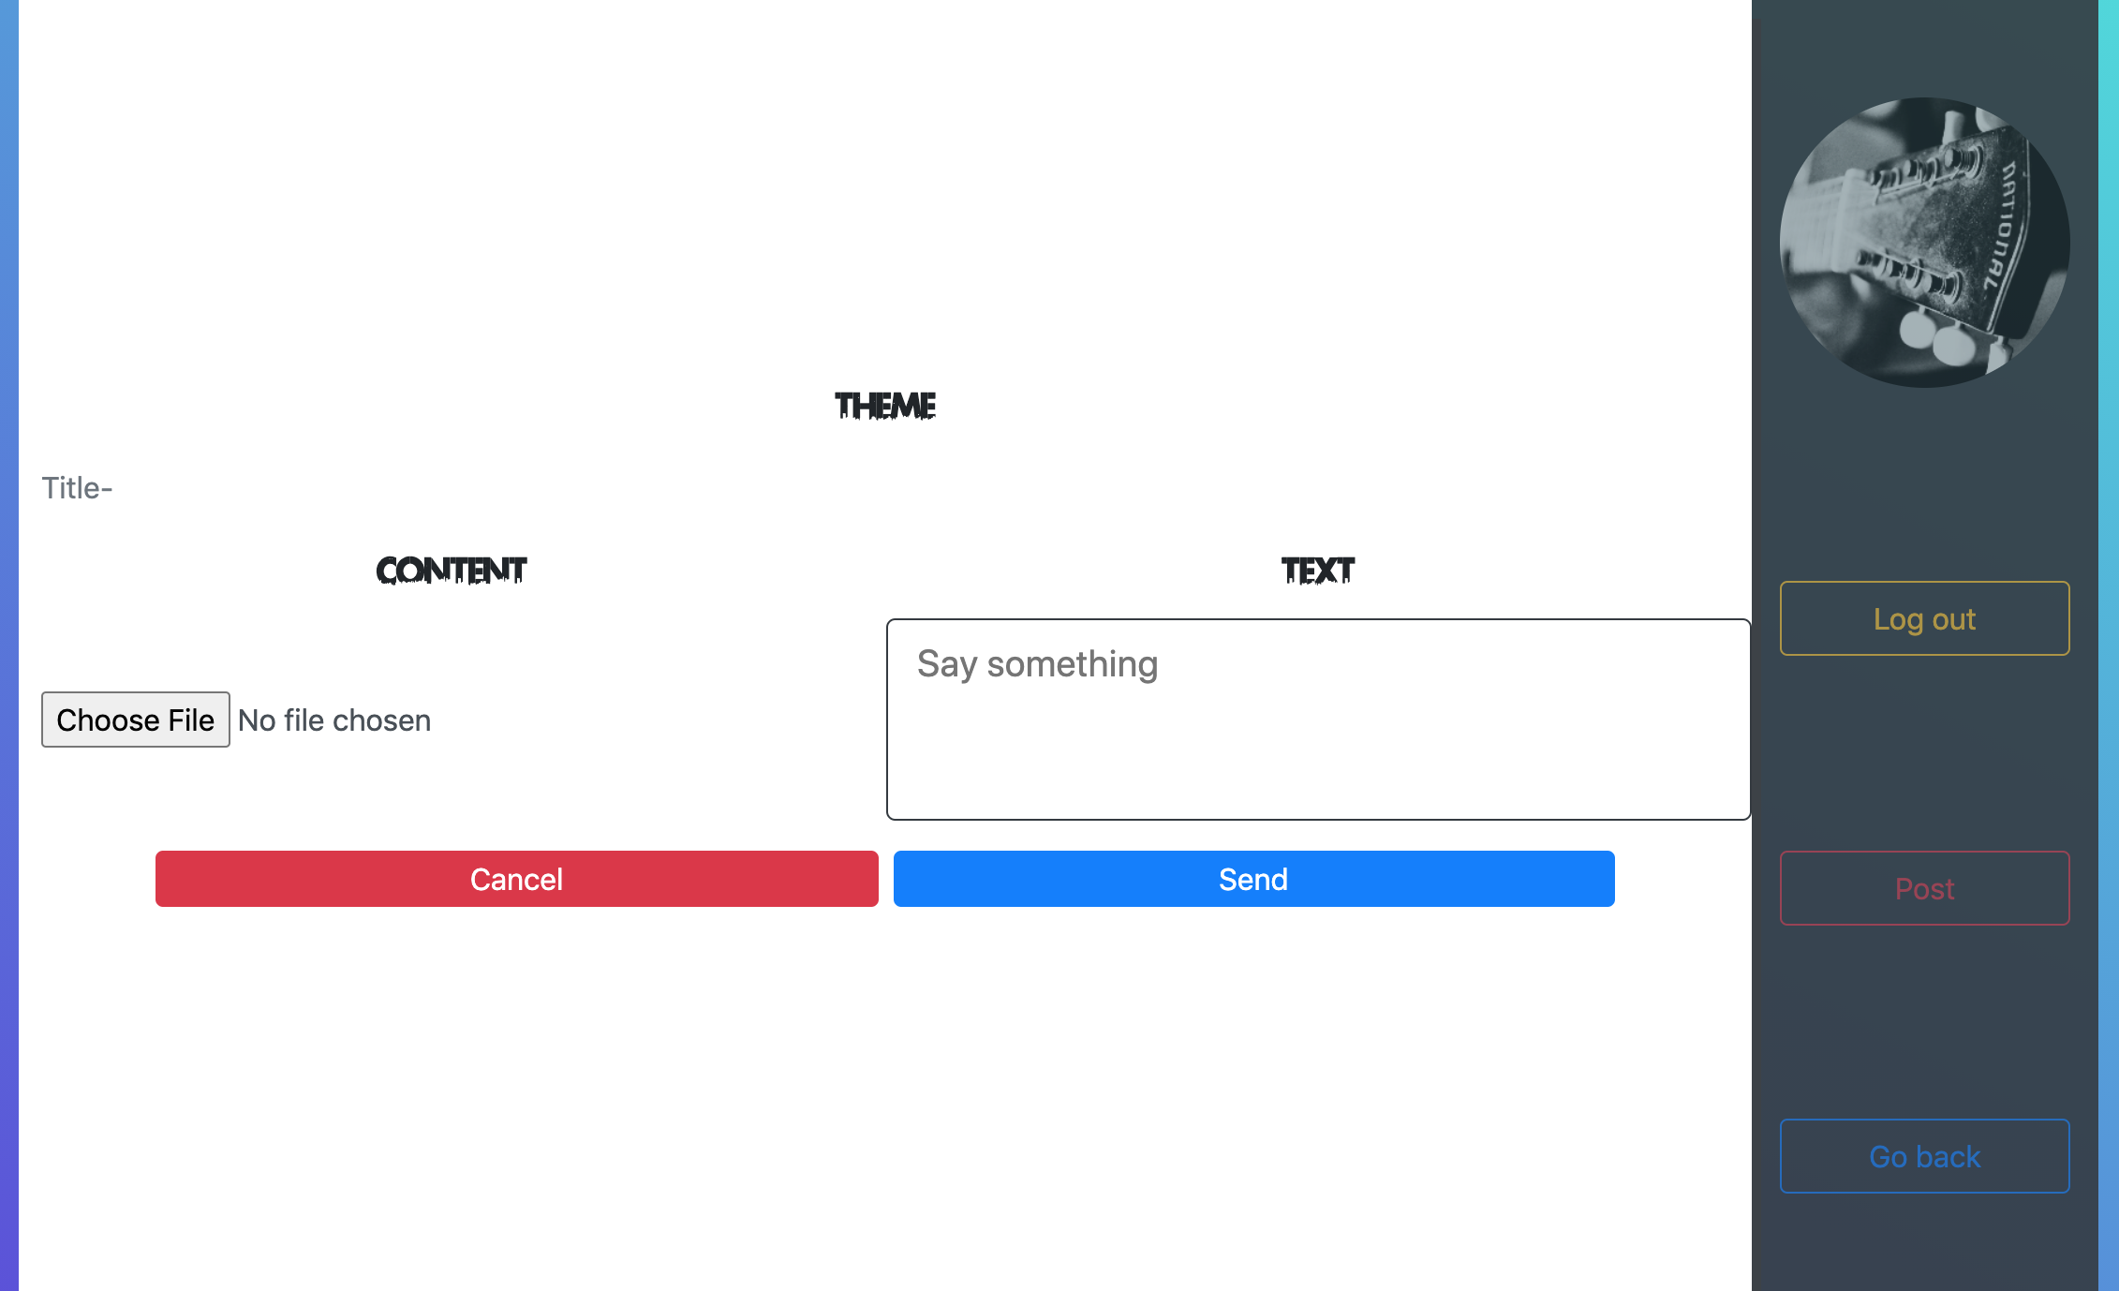
3.1 Post a thread
Post a new thread

Slide 8
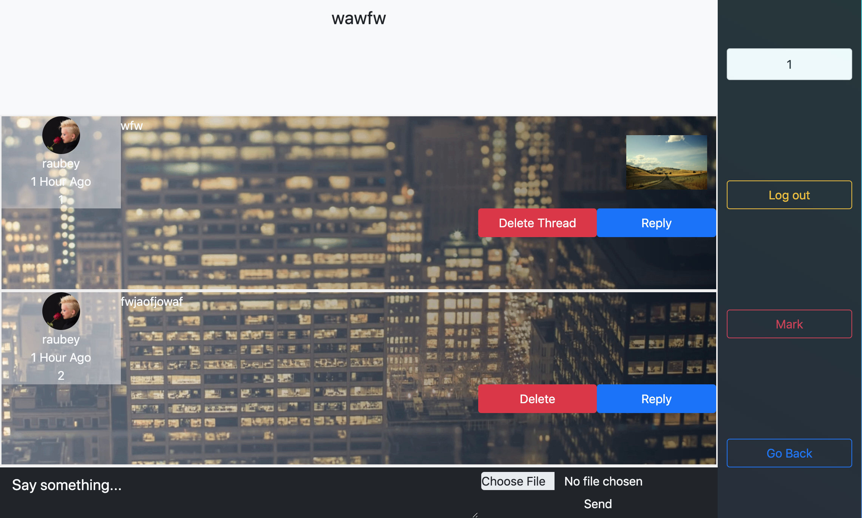
4. Thread page
Leave comments / Reply to comments

Slide 9
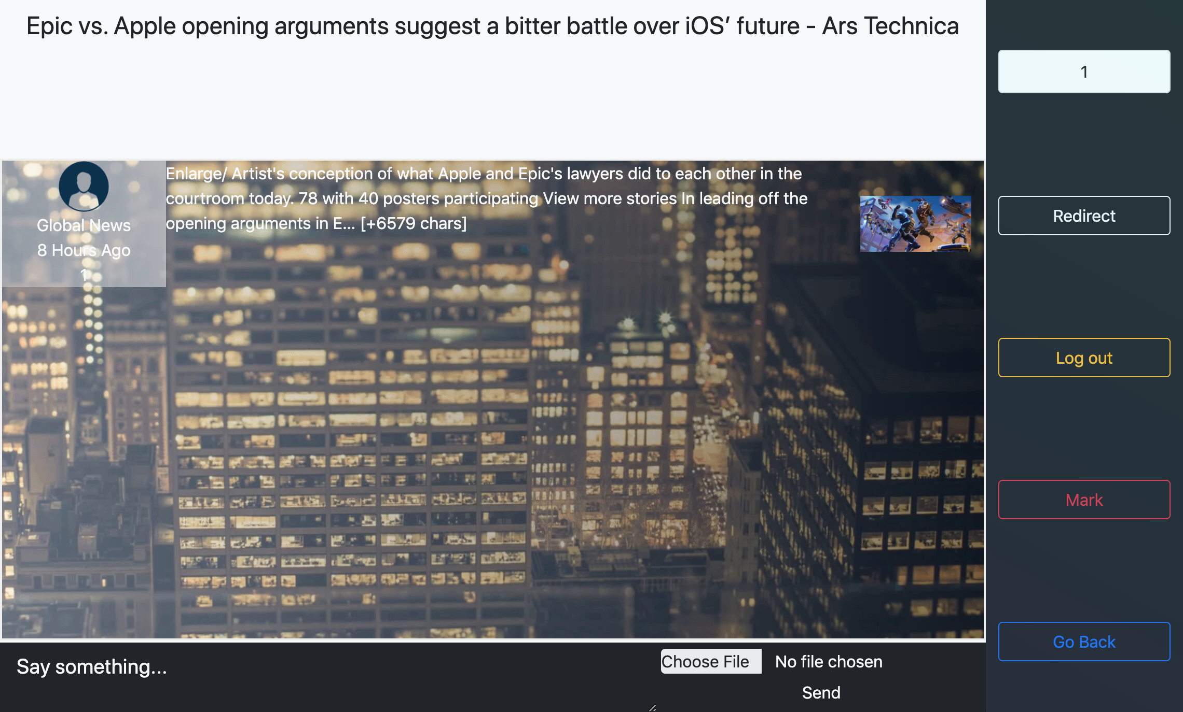
4. News Page
View the news content / Redirect to the original page
Leave comments / Mark the page

Slide 10
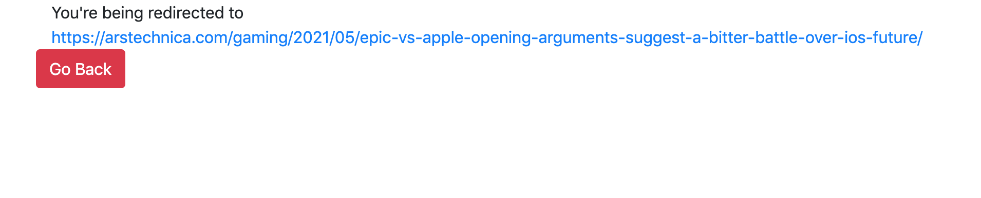
4.1 Redirect Page
Click the url to check the original page

Slide 11
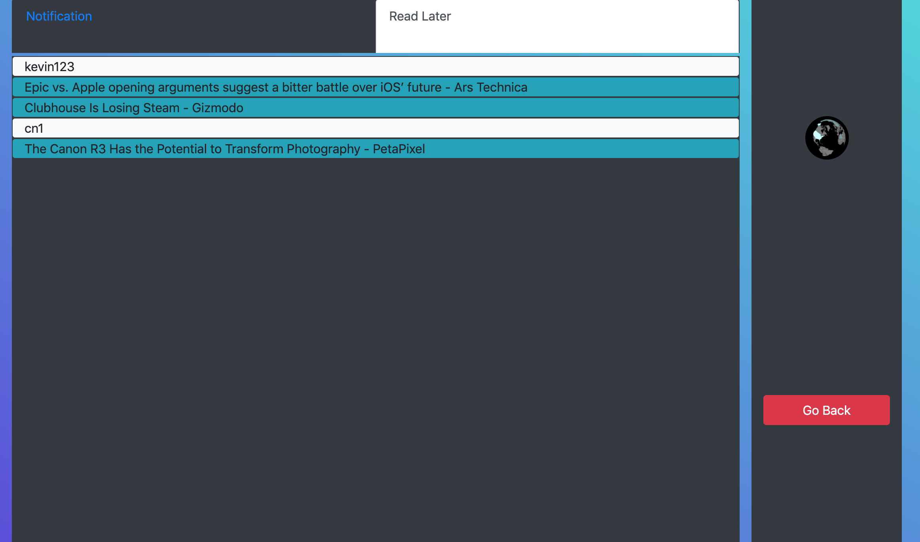
5. User page
View the replies, marked pages / Change the profile image
(Click the title to go to the news)

Slide 12
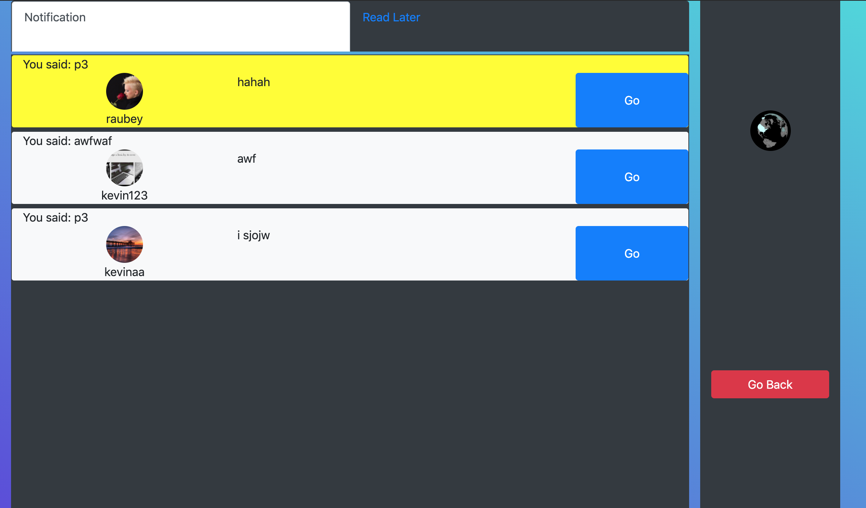
5.1 View other user’s replies
New replies have the yellow background
(Click the “Go” button to the page)

Slide 13
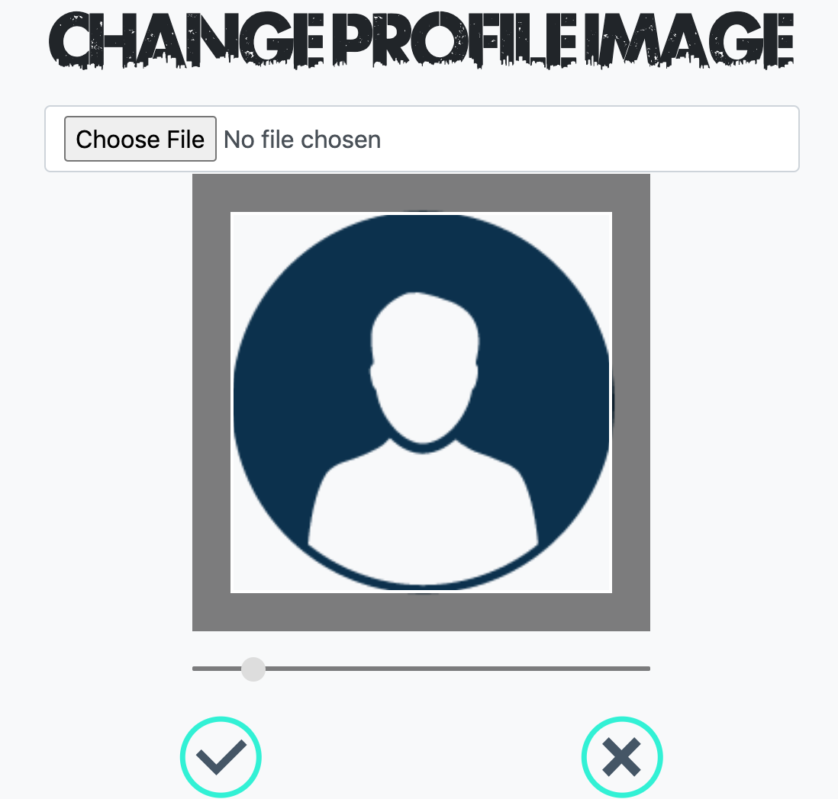
5.2 Change Profile Image
Change the profile image

Slide 14
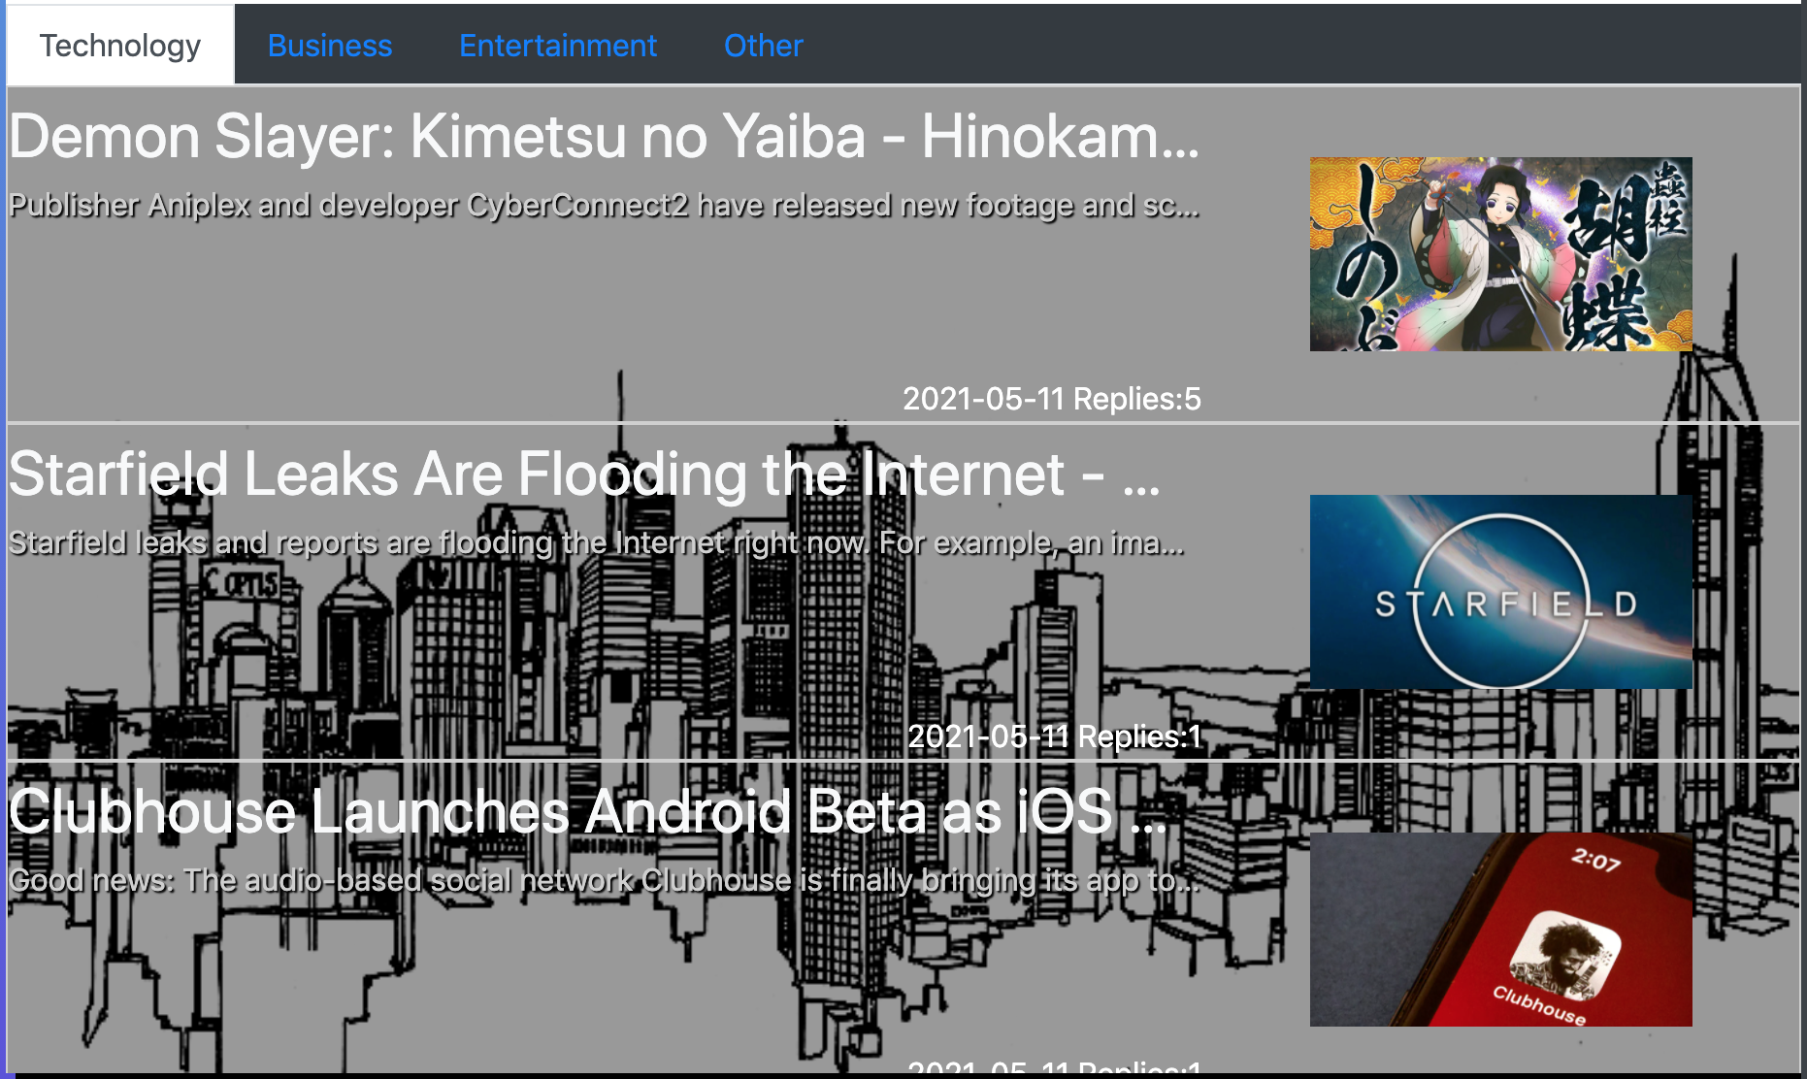
6. Auto Update
The news content will update automatically every day.

Slide 15
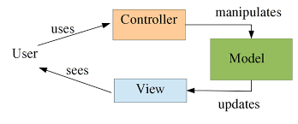
Architecture Patterns - MVC
Model: MySQL database
View: HTML web pages
Controller: Components on the website (Forms, inputs)

Slide 16

Architecture Patterns - Client / Server
The website runs on Apache HTTP web server.
Users use browsers to view the website.

Slide 17
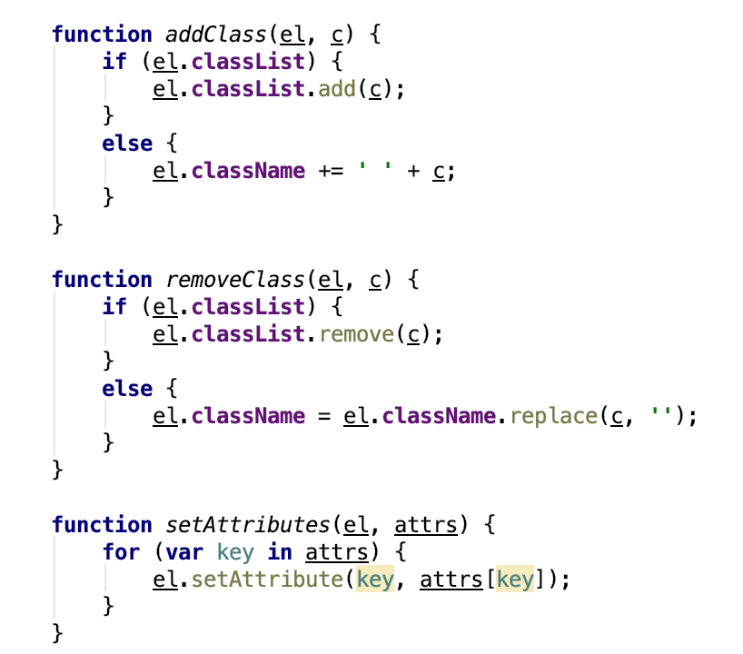
Design Principle - Single Responsibility
Each function only focus on one task.

Slide 18
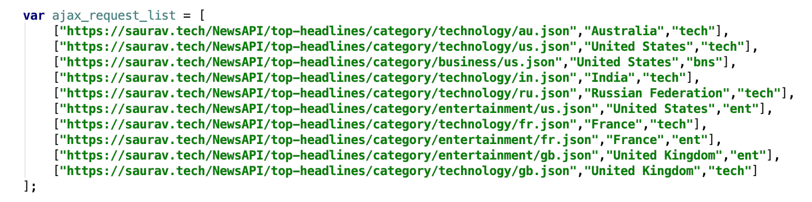
Design Principle - Open/Close
Each function only focus on one task.

Slide 19
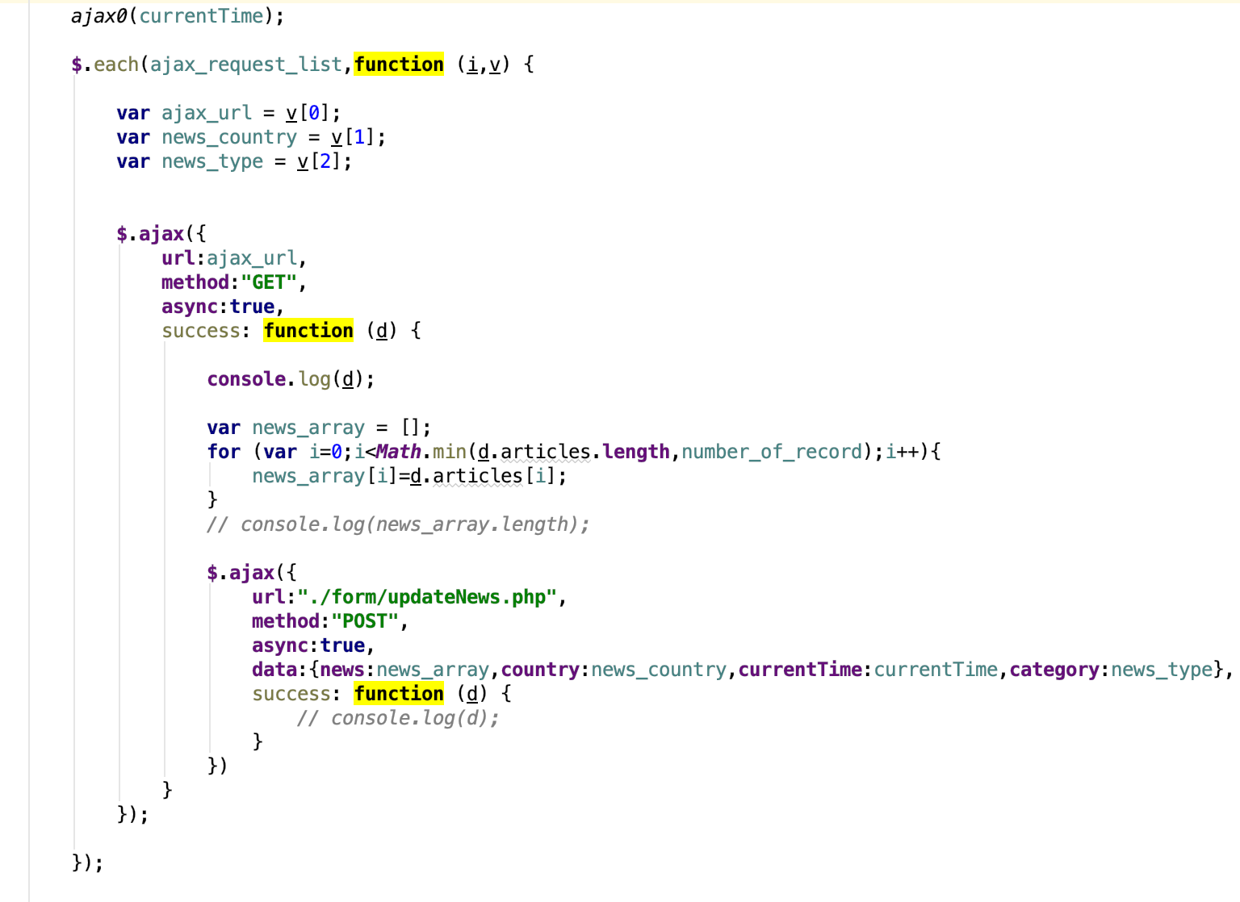
Design Principle - Open/Close
To add more news apis, just need to add
elements in the list without changing the code.

Slide 20
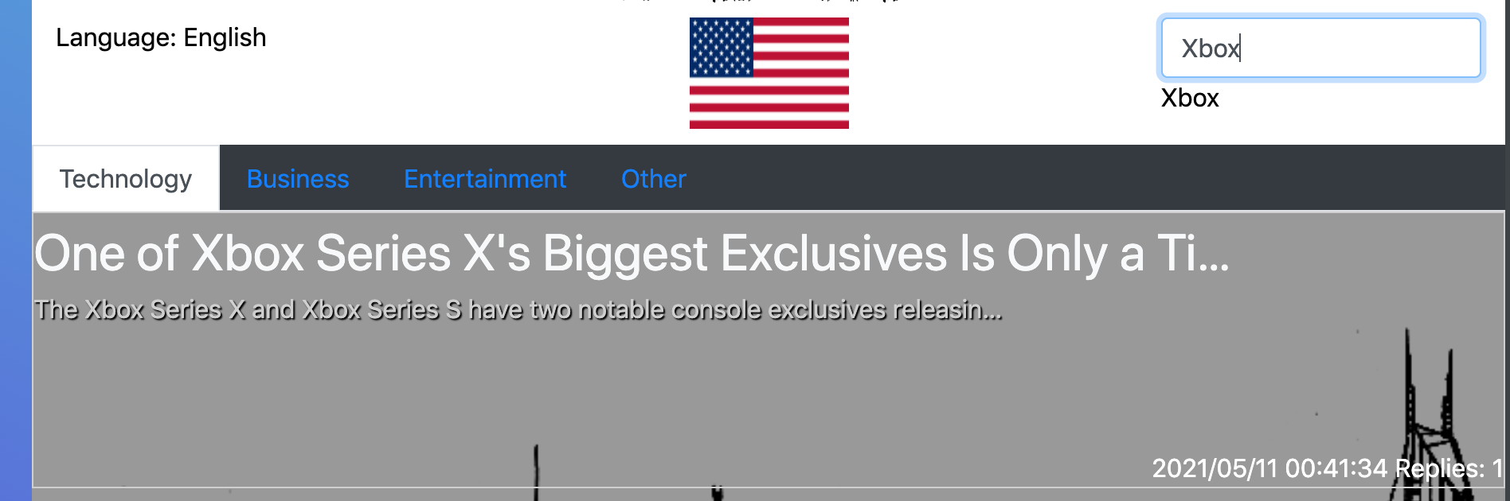
Design Pattern - Observer
The result changes correspondingly based on the status of input bar.
Input bar = Subject / Result list = Observer

Slide 21
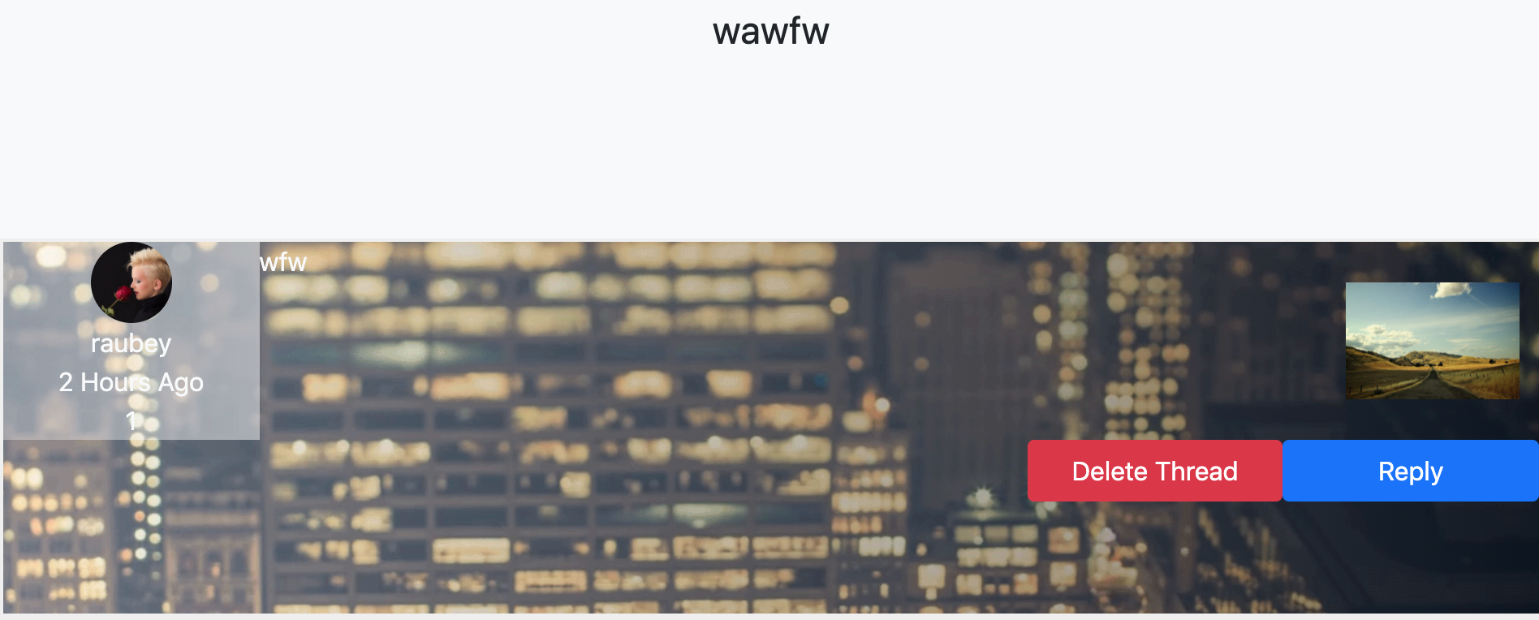
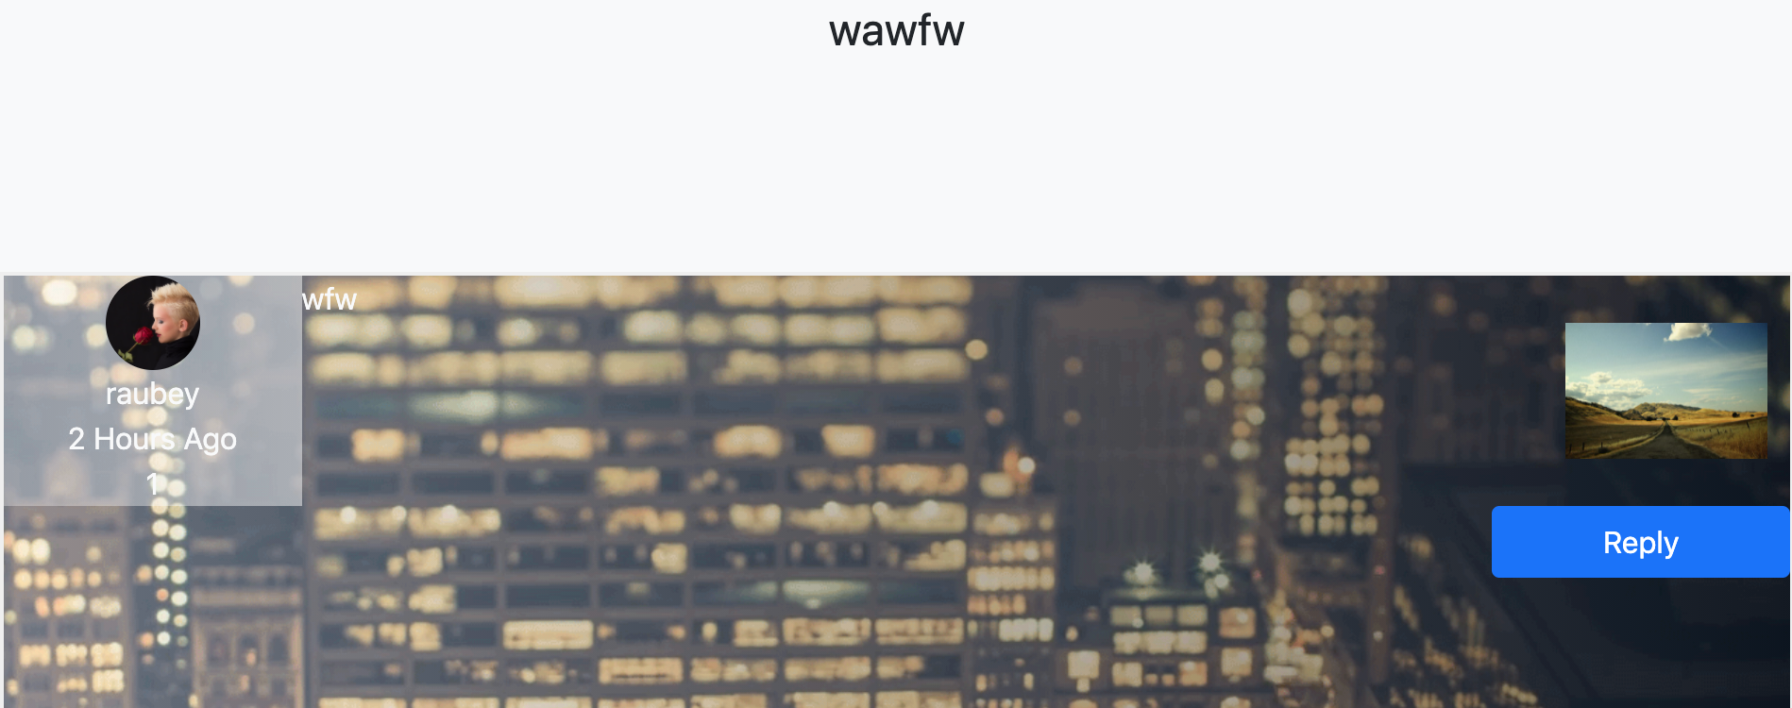
Design Pattern - Decorator
Used to give different user different privileges.

Slide 22
Design Pattern - Iterator
There are multiple functions in javaScript and jQuery utilize the Iterator pattern.

Slide 23
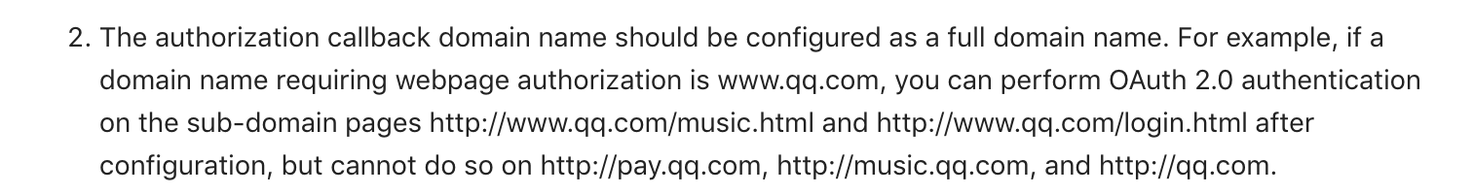
About WeChat API
It requires a valid domain name.
Since our project runs on a local server, so can’t we can’t use WeChat API to implement Social Login functionality.

Slide 24
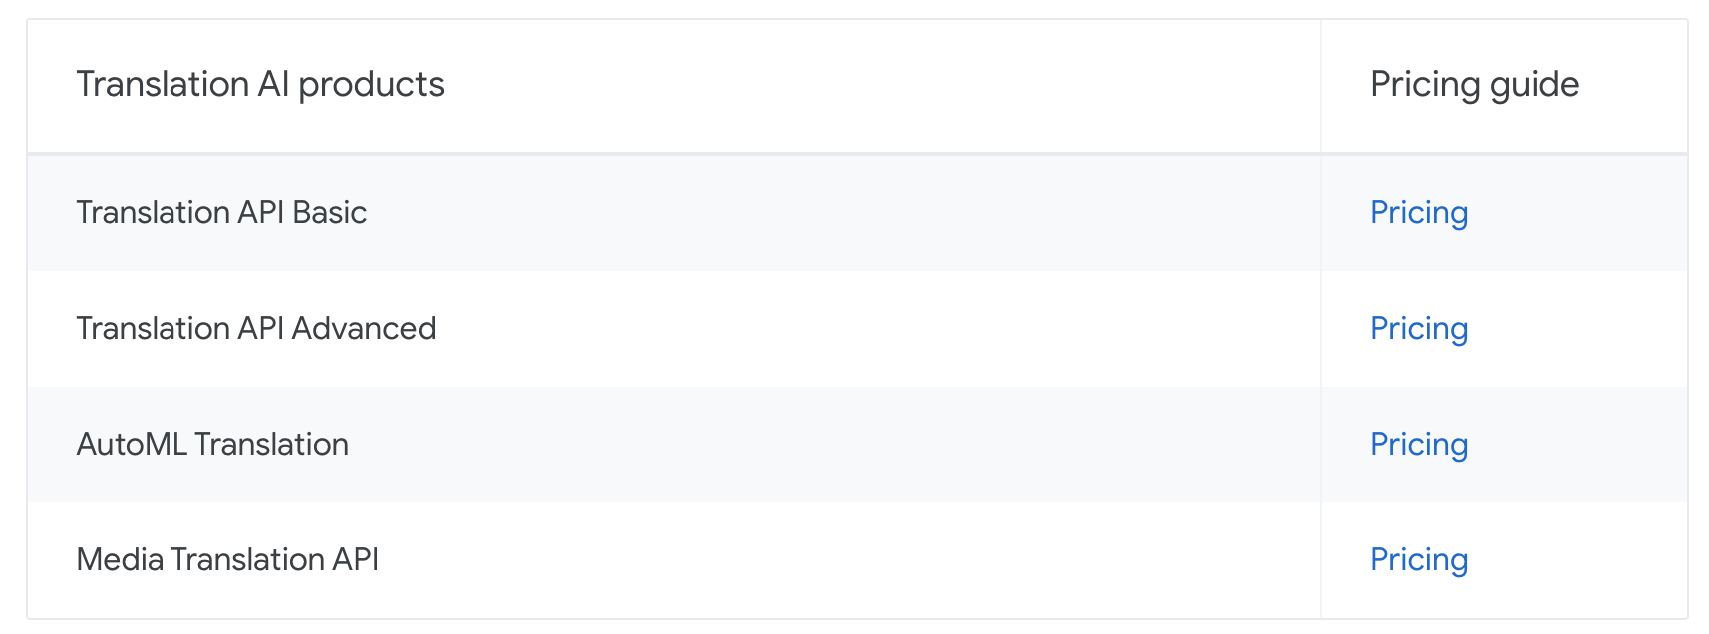
About Google Translation API
Because Google Translation API is not free to us, and the translation functionality is not the most important part of our project. So we chose not to use it.

Slide 25
About other optional functionalities
We failed to implement some optional functionalities like the recommendation system because we didn’t have enough to do that. We wanted to focus on the most basic and essential functionalities first.

Slide 26
Thanks

